Slide 1
Why Learn Java ?
Used widely in industry.
Useful for a very wide variety of purposes, including:
  2D/3D games,
  web applications and web services,
  applets / Java web start in web pages (deprecated)
  stand-alone applications,
  Similar to other popular languages: C++, C#, etc.
A popular programming language, which has steadily increased in popularity over the years. ☺
Job Stats by Programming Language Author(s): Mike O’Malley Slide: <number>

Slide 2
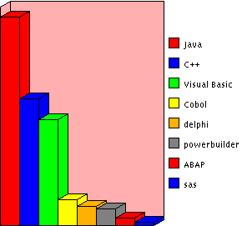

Jobs Stats by Programming Language @ Aug-2001
Valid at : 2-August-2001
http://www.itcareers.acs.org.au/
Job Stats by Programming Language Author(s): Mike O’Malley Slide: <number>

Slide 3
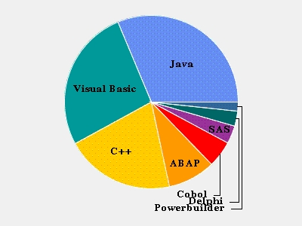

Jobs Stats by Programming Language @ Nov-2003
Valid at : 13-Nov-2003
http://jobstats.jobnet.com.au/jobtools/jsjobstats.DISPLAYJOBSTATS
Job Stats by Programming Language Author(s): Mike O’Malley Slide: <number>

Slide 4
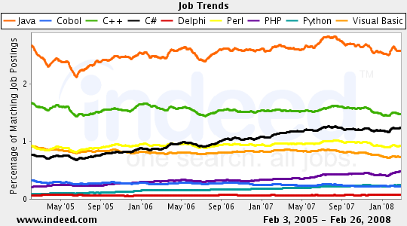

Jobs Stats by Programming Language @ Apr-2008
Indeed.com searches millions of jobs from thousands of job sites.
Valid at : 7-April-2008
http://www.indeed.com/jobtrends
Job Stats by Programming Language Author(s): Mike O’Malley Slide: <number>

Slide 5
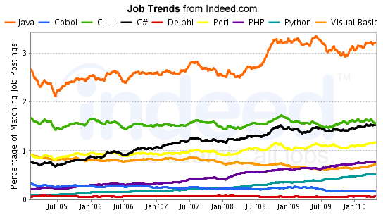
Jobs Stats by Programming Language @ July-2010
Indeed.com searches millions of jobs from thousands of job sites.
http://www.indeed.com/jobtrends
Job Stats by Programming Language Author(s): Mike O’Malley Slide: <number>

Slide 6
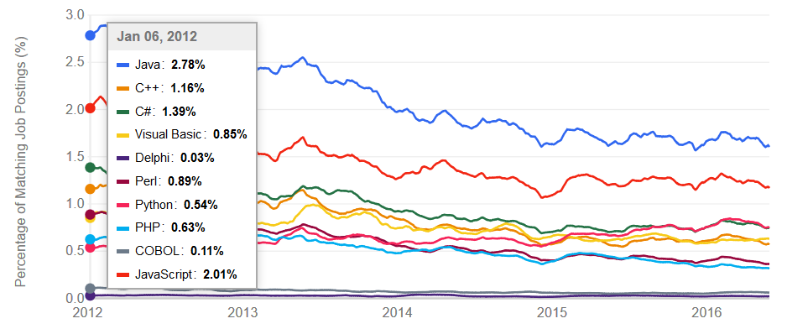
Jobs Stats by Programming Language @ Jan-2012
Indeed.com searches millions of jobs from thousands of job sites.
http://www.indeed.com/jobtrends
Job Stats by Programming Language Author(s): Mike O’Malley Slide: <number>

Slide 7
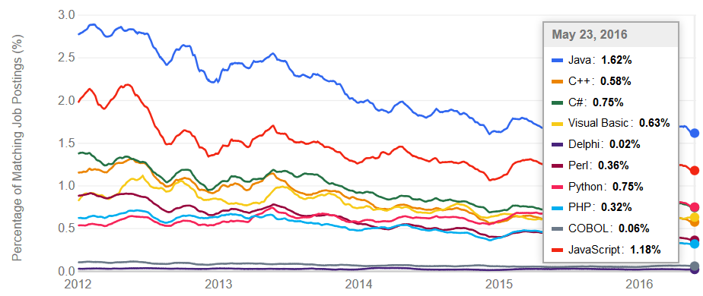
Jobs Stats by Programming Language @ May-2016
Indeed.com searches millions of jobs from thousands of job sites.
http://www.indeed.com/jobtrends
Job Stats by Programming Language Author(s): Mike O’Malley Slide: <number>

Slide 8
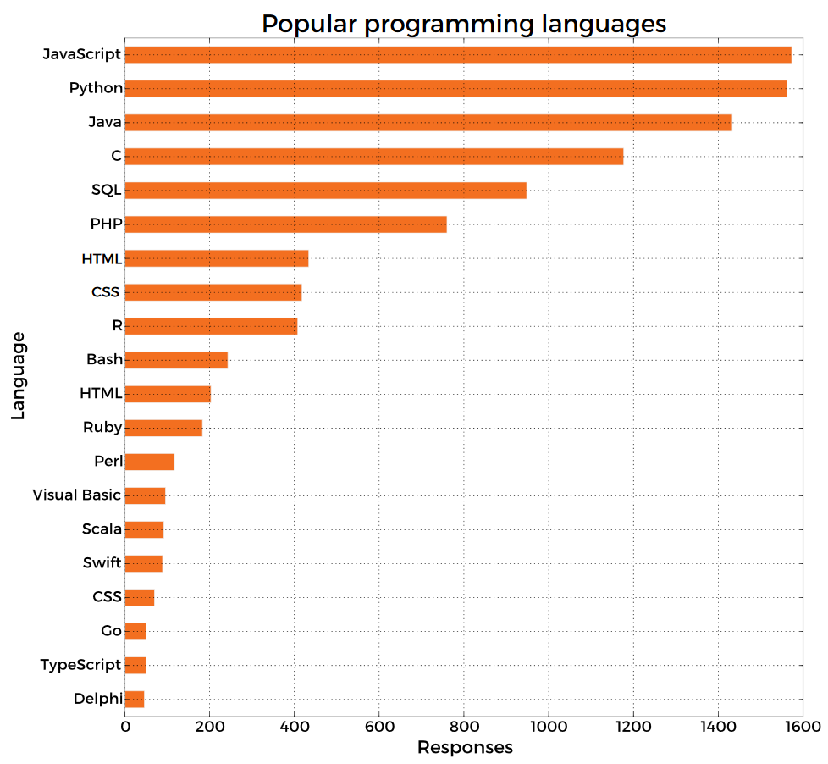
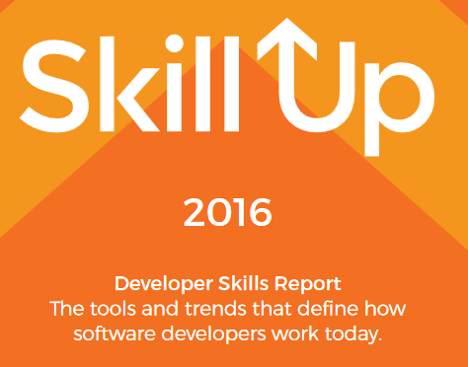
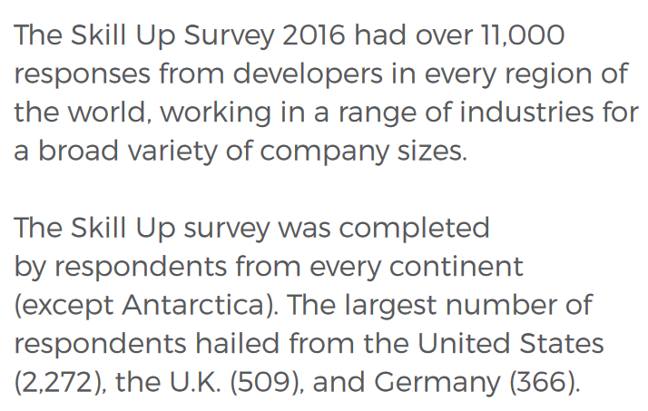
Jobs Stats by Programming Language @ 2016
Ref: https://www.packtpub.com/skill-up-2016
Job Stats by Programming Language Author(s): Mike O’Malley Slide: <number>

Slide 9
Jobs Stats by Programming Language
Moral of these Job stats:
  Java has been a very popular language for many years.
  There are lots of jobs in Java.
  Java is a useful skill to have.
Advice:
  Work hard to develop your skills (such as Java, SQL, HTML, CSS, etc ….).
  Add new skills to your arsenal at every opportunity to maximise your employment prospects for the future.
Job Stats by Programming Language Author(s): Mike O’Malley Slide: <number>

